Slide 1

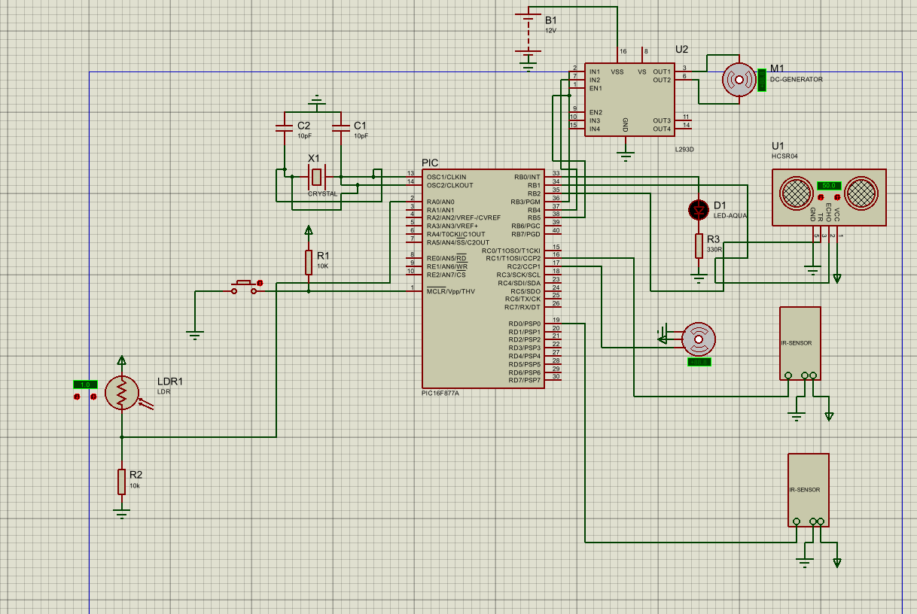
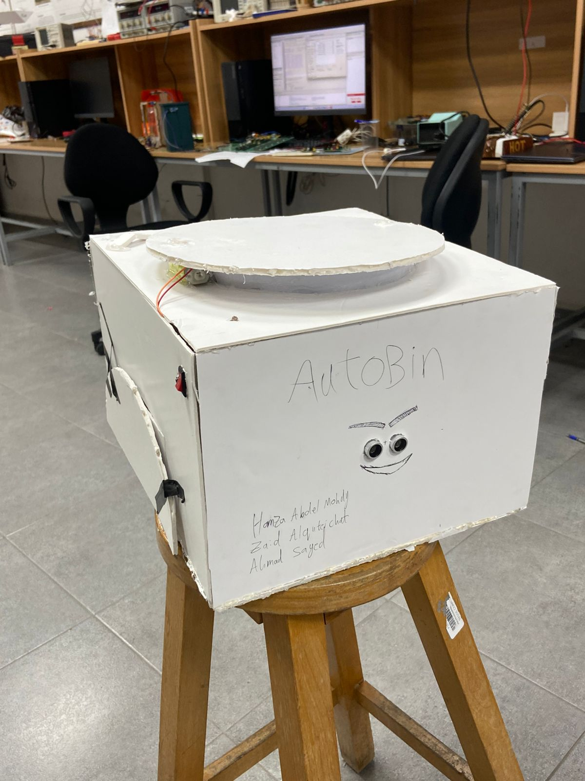
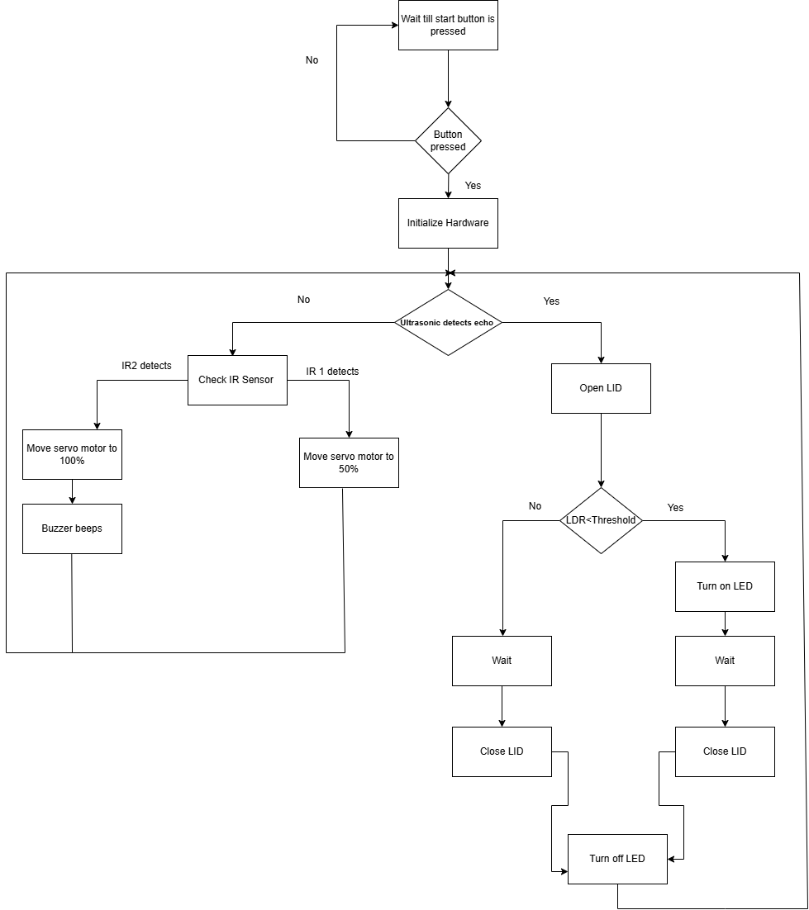
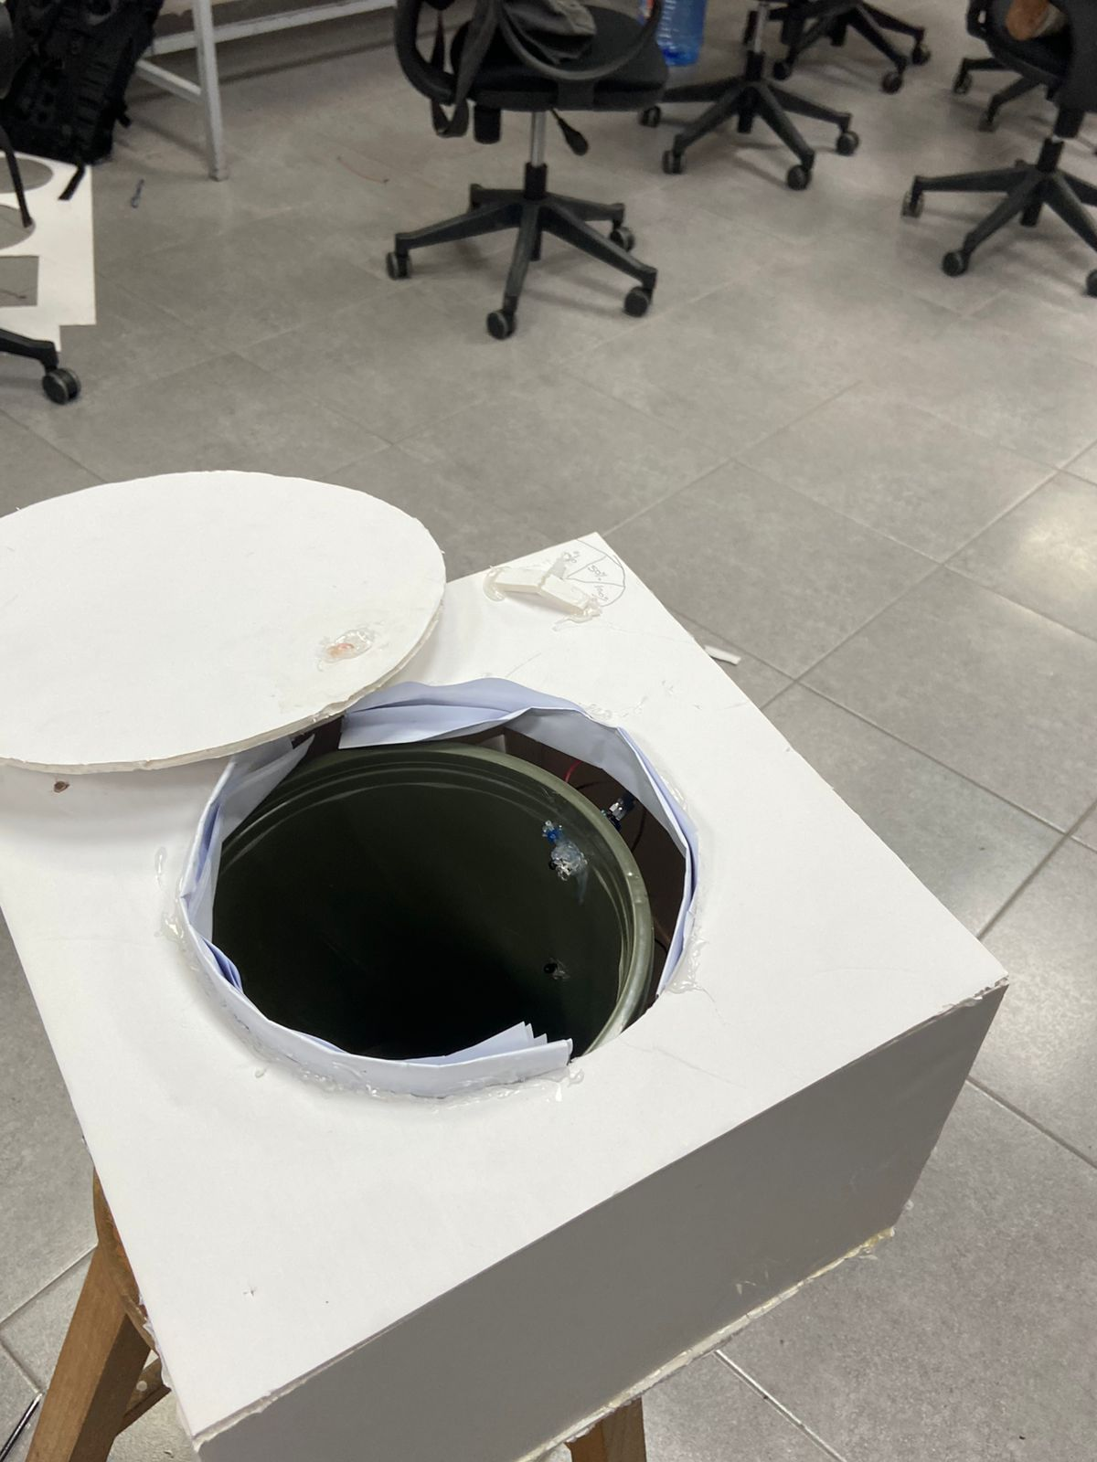
AutoBin
Z.Qutiechat, H.Abdel-Mohdy, A.Rabia
Supervisor: Dr. Belal Sababha
Embedded Systems Final Design Project, Spring 2025
King Abdullah II School of Engineering
Princess Sumaya University for Technology
Introduction
The AutoBin© is a smart waste management solution designed to modernize the simple act of throwing out garbage. By using a combination of ultrasonic sensors, IR detectors, a servo motor, and an LDR, this system automates lid opening, monitors bin fill levels, and activates visual and audio alerts when full. It offers a hygienic, hands-free experience and promotes timely disposal, making it ideal for both homes and public spaces.
Figure 2: Hardware Design
Results
Figure 3: AutoBin
Figure 4: AutoBin from Inside
Design
The AutoBin© design integrates multiple components controlled by a PIC16F877A microcontroller. An ultrasonic sensor detects proximity and triggers a DC motor via an H-Bridge to open and close the lid. Two IR sensors placed under the lid detect garbage levels and light up LEDs to indicate 0% , 50%, and 100% fill states. A buzzer sounds when the bin is full. An LDR sensor controls a nightlight (LED) that activates in low-light environments. All components are powered using an external 5V supply with proper interfacing for reliable performance.
Figure 1: Software Design
Conclusion
AutoBin© successfully combines multiple sensors and actuators into a single system that improves the user’s interaction with waste bins. The automated lid, fill detection, and smart lighting make it more hygienic, especially in shared or public spaces. This project reflects the potential of microcontroller-based solutions in creating cleaner, smarter, and more efficient environments.

